Slide 1
Supplementary Slides on Multi-Threading for our Blackboard Collaborate sessions
comp1206 Programming II
Andy Gravell, May 2020

Slide 2
Multi-Threading Session 1
I expect you have viewed the lecture 1 slides and/or recording
You should understand why multi-threading is now standard
And also the programming challenges such as
non-determinism, update anomalies, deadlock, livelock / starvation
The recommended solutions are:
confinement (or thread local data)
immutable objects
library classes with thread safe methods
safe synchronisation

Slide 3
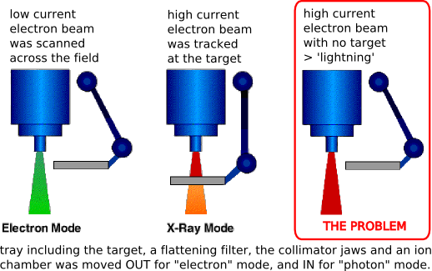
Therac 25 [from: David Stotts, UNC, Epic Software Failure on slideplayer.com]

Slide 4
How could this happen?
The tray, like any physical object, takes time to move
so it has to be controlled by its own thread
The user input is processed on a different thread
Setting the beam mode and moving the tray occur concurrently
So the design must ensure safe synchronisation
It is not clear the designers and programmers understood this
Errors occurred only infrequently, and not during testing
perhaps because the live operators could enter data more quickly
Debugging such problems is not easy
Multiple incidents occurred before the issue was understood

Slide 5
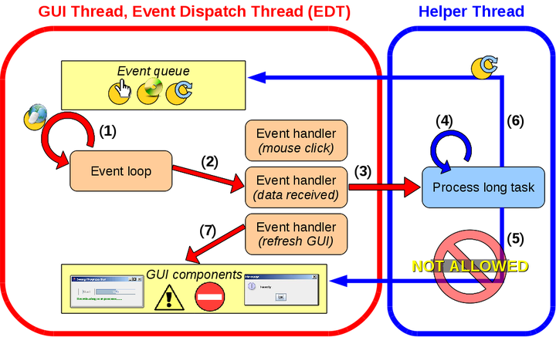
Parallel and Reconfigurable Computing Lab, The University of Auckland

Slide 6
Questions to Ponder
Which object on this diagram is shared?
How is this object protected from update anomalies?
Which objects on this diagram are thread local?
What rule protects these from update anomalies?
How does JavaFX police this rule?
In a GUI system, what triggers thread switching?
A reminder: Blackboard has test questions for all topic 3 material
you can attempt these multiple times to prepare for the end of module test

Slide 7
Some Possible Answers
Which object on this diagram is shared? The event queue
How is this object protected from update anomalies? Synchronised put and get methods Inter-thread method arguments are also shared, so these should be immutable or read-only
Which objects on this diagram are thread local? The GUI components
What rule protects these from update anomalies? Thread local means only one thread can set (write) and get (read) them
How does JavaFX police this rule? Check the thread ID, raise an exception if violated, see eg https://stackoverflow.com/questions/50221187/javafx-call-a-function-in-a-thread
In a GUI system, what triggers thread switching? User input (keyboard, mouse, …) generates hardware interrupts The kernel/OS/JVM then force a thread switch

Slide 8
Session 2: Safe Synchronisation this session supplements the lecture 2 recording and slides
Our multi-threaded code must be predictable and responsive
Synchronisation enables us to avoid update anomalies
these anomalies are a major cause of non-deterministic behaviour
To use a synchronised library method, call it in the usual way
Making your own methods synchronised, just add one keyword
synchronized ( object ) { code } // a synchronised block
synchronized MyClass foo() { code } // a synchronised method
We need to understand how this technique works to use it correctly
Synchronisation locks the object
two threads cannot both execute the code / method body at the same time

Slide 9
Some Questions
What object does a synchronised instance method lock?
What object does a synchronised class method lock?
What occurs if there is another call to the same synchronised method?
Which objects synchronise here, i.e. these objects agree the time?
How can you tell if a library method is synchronised?
Why is the Java keyword spelled that way?

Slide 10
Avoiding Update Anomalies / Data Corruption
Synchronise code that updates a shared object
e.g. to move a Point along the leading diagonal both x and y must be updated
Synchronise code that updates or reads a shared object
it should not be possible to read (get) different values for x and y
the code should preserve the invariant that p.x == p.y for each Point p
Synchronise code that updates or reads a shared object or objects
if the objects are related and some invariant must be preserved
e.g. mySavings.balance + myCurrent.balance is unchanged by moving between A/Cs
The scope of synchronisation must cover the scope of the invariant
just the variables that the invariant mentions, or at most a few extra ones

Slide 11
Ensuring Progress / Responsiveness
Suppose objects o1, o2, o3, … have a synchronised method m()
If thread t1 calls o1.m(), and then t2 also does, t2 blocks & must wait
Consider a graph showing which thread is blocked by another

Slide 12
Ensuring Progress / Responsiveness
Suppose objects o1, o2, o3, … have a synchronised method m()
If thread t1 calls o1.m(), and then t2 also does, t2 blocks & must wait
Consider a graph showing which thread is blocked by another
t3
t2
t4
t1
t5

Slide 13
Ensuring Progress / Responsiveness
Suppose objects o1, o2, o3, … have a synchronised method m()
If thread t1 calls o1.m(), and then t2 also does, t2 blocks & must wait
Consider a graph showing which thread is blocked by another
If there is a cycle, then the threads will deadlock
none of them can make progress, as each is waiting on the next
deadlock can be avoided by always acquiring locks in the same order, eg A, B, C
note that avoiding deadlock is only part of ensuring progress, however
t3
t2
t4
t1
t5

Slide 14
Some Questions
What would be the disadvantages of synchronising all methods?
If a synchronised call is blocked, what then causes it to be unblocked?
If more than one thread is blocked, which one is chosen to continue?
What is the smallest number of threads needed for deadlock to occur?
What is the smallest number of locks needed for deadlock to occur?
Other than locking in numeric order, how else can deadlock be avoided?
How else can you identify objects needing mutual synchronisation?
Can a constructor be synchronised?

Slide 15
Some Possible Answers
What object does a synchronised instance method lock? The this object
What object does a synchronised class method lock? The object representing the class itself
What occurs if there is another call to the same synchronised method? Second / subsequent calls block the thread, and must wait for their turn
Which objects synchronise here, i.e. these objects agree the time? The threads calling the synchronised method (or code block)
How can you tell if a library method is synchronised? The documentation should state that it is thread safe if it is synchronised
Why is the Java keyword spelled that way? US spelling is different cf UK spelling

Slide 16
Some Possible Answers
What would be the disadvantages of synchronising all methods? Deadlock is more likely; reduced concurrency leads to slower progress
If a synchronised call is blocked, what then causes it to be unblocked? The blocking thread finishes executing the synchronised code releasing the lock
If more than one thread is blocked, which one is chosen to continue? Assume that the selection is random: priorities are only hints to the scheduler
What is the smallest number of threads needed for deadlock to occur?
What is the smallest number of locks needed for deadlock to occur? Two threads with two locks can form a cycle, leading to deadlock
Other than locking in numeric order, how else can deadlock be avoided? Ensure each thread only locks at most one object at any given time
How else can you identify objects needing mutual synchronisation? The objects all read by a single method probably need mutual protection
Can a constructor be synchronised? No: https://cse.iitkgp.ac.in/~dsamanta/java/ch6.htm

Slide 17
Session 3: Thread Progress & Responsiveness this session supplements the lecture 3 recording and slides
Ensuring progress requires more than avoiding deadlock
problems such as livelock or (resource) starvation can occur
The standard GUI architecture gives a standard solution
a main thread, one or more helper threads, shared event/message queues
this is well supported by standard java library classes and methods
for example, java.util.concurrent and javaFX.concurrent
But progress may be application and thread specific
the kitchen will be happy if only one dining philosopher is regularly eating
but each philosopher will no doubt expect to eat from time to time
to solve such a problem, you may need a special-purpose solution

Slide 18
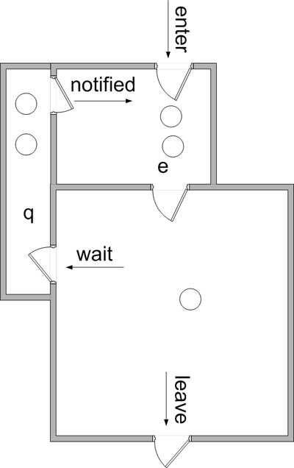
Java Monitors (source: Wikipedia)
Each object o can be used as a monitor
a queue of waiting threads, plus its lock
Only call o.wait() in synchronized code
to join the queue of waiting threads
the wait queue is really a waiting set
Likewise for o.notify(), o.notifyAll()
the notified object(s) may now progress
though only one can acquire o’s lock
once the notifying thread has released it
o.notify() returns if no thread is waiting
which may lead to deadlock later ☹

Slide 19
Some Questions
Why does this diagram have two waiting rooms, q and e?
What happens if you call o.wait() without first synchronising on o?
Why doesn’t this lead to o being permanently unavailable?
Can a thread acquire a lock it has already obtained?
How can an application progress even if one of its threads is blocked?
How can an application avoid deadlock by calling o.notify() too early?

Slide 20
Monitors as Building Blocks
Monitors can be used to build useful concurrent data structures
They are a building block, not a complete solution
For example, a shared message box might have code such as
public synchronized void put(String msg) {
while (!empty) { // loop until this condition is satisfied
try { wait(); // relinquish control while waiting
} catch (InterruptedException e) { } // we don’t expect this to happen
} // we have now entered the monitor’s “main room”
empty = false; // get() can proceed when there is a new message
this.msg = msg; // which is available via this instance variable
notifyAll(); // finally, wake up any thread that may be waiting
}

Slide 21
Some Questions
In the previous example, is this still locked after the call to wait()?
In the previous example, what condition will the get() method test?
What use is o.notify() when we don’t know which thread wakes up?
What are the disadvantages of calling o.notifyAll()?
What is it called if you loop without waiting after testing a condition?
Which famous computer scientists invented the monitor?
What is the usual CS word for absence of deadlock, livelock & starvation?

Slide 22
Some Possible Answers
Why does this diagram have two waiting rooms, q and e? One is for the wait set, the other for threads about to synchronise
What happens if you call o.wait() without first synchronising on o? An IllegalMonitorStateException
Why doesn’t this lead to o being permanently unavailable? Waiting also implicitly released o’s synchronisation lock
Can a thread acquire a lock it has already obtained? Yes: https://docs.oracle.com/javase/tutorial/essential/concurrency/locksync.html
How can an application progress even if one of its threads is blocked? A different thread may find the required solution, eg if using a thread pool
How can an application avoid deadlock by calling o.notify() too early? Main method initialises objects before starting threads Add extra state to the object so the situation can be tested for

Slide 23
Some Possible Answers
In the previous example, is this still locked after the call to wait()? Yes, it is released during the wait, and then the lock is re-acquired
In the previous example, what condition will the get() method test? The opposite of put(), i.e. empty
What use is o.notify() when we don’t know which thread wakes up? It is useful when using a pool of identical threads
What are the disadvantages of calling o.notifyAll()? Time-consuming to wake up all threads if only one can proceed
What is it called if you loop without waiting after testing a condition? Busy wait
Which famous computer scientists invented the monitor? Tony Hoare and Per Brinch Hansen
What is the usual CS word for absence of deadlock, livelock & starvation? Liveness (which I have called progress and responsiveness here)

